Slide 1
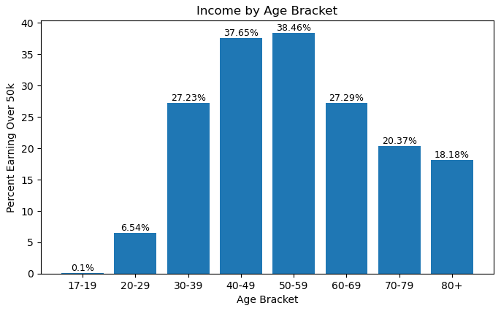
Conor Byrne & Patrick Hagelston
Results Presentation

Slide 2
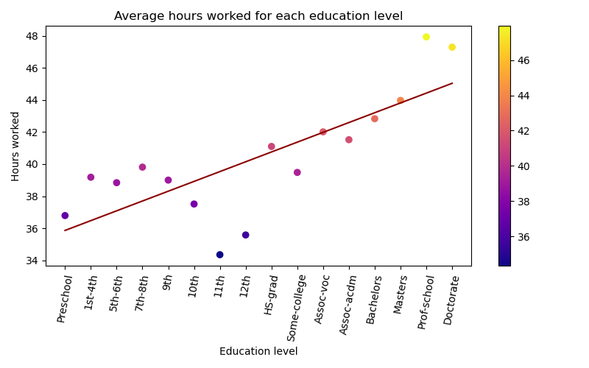
Conor Byrne & Patrick Hagelston
Results Presentation

Slide 3
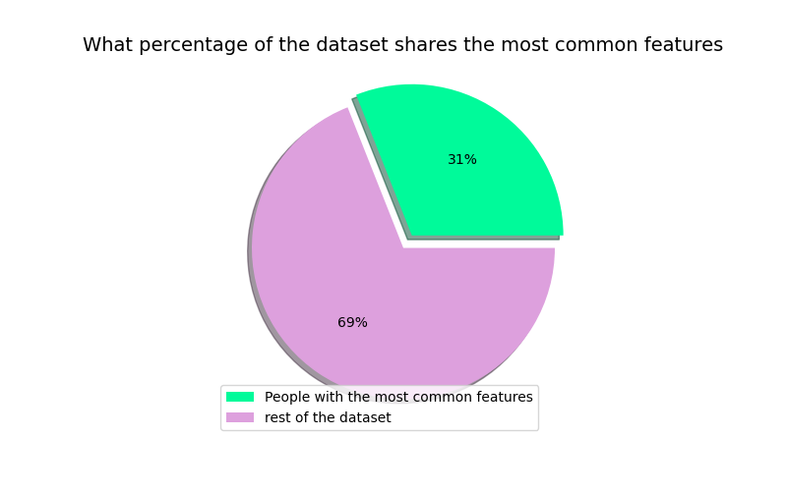
Conor Byrne & Patrick Hagelston
Results Presentation

Slide 4
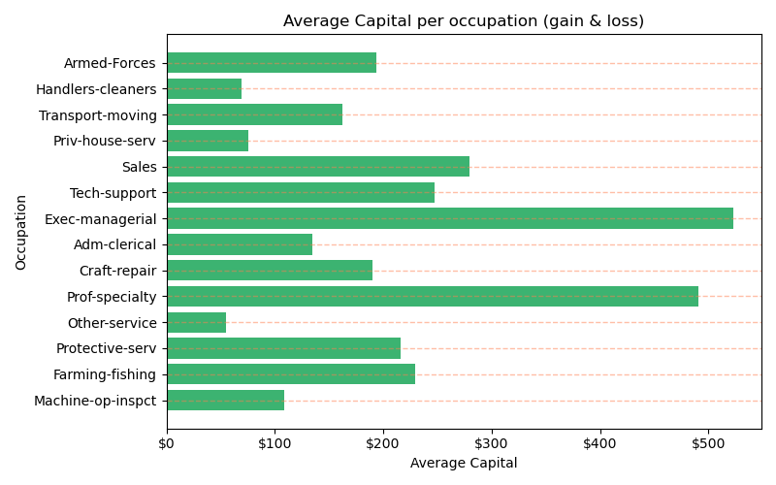
Conor Byrne & Patrick Hagelston
Results Presentation

Slide 5
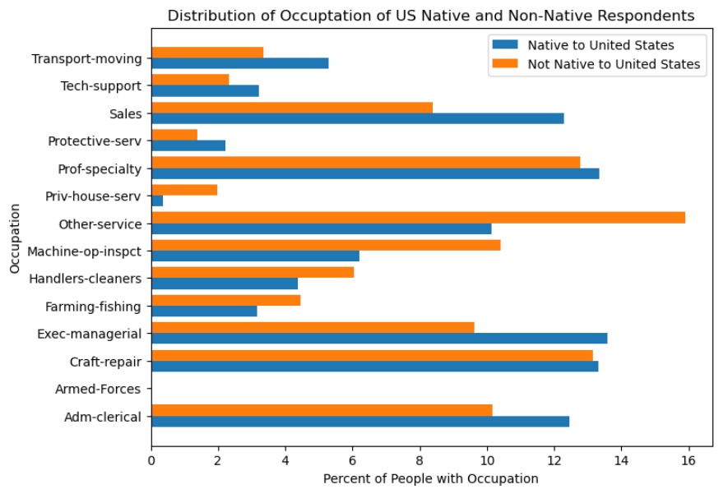
Conor Byrne & Patrick Hagelston
Results Presentation

Slide 6
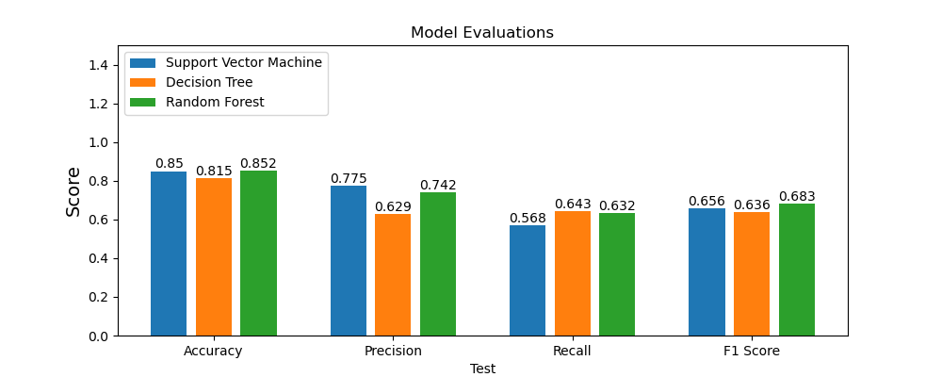
Evaluation of all 3 models
Conor Byrne & Patrick Hagelston
Results Presentation

